Slide 1
Introduction to Artificial Intelligence Applications and Practices
Machine Learning
Prof. Pin Luarn
luarn@yahoo.com
luarn@mail.ntust.edu.tw

Slide 2


Learn from experience
Learn from data

Slide 3
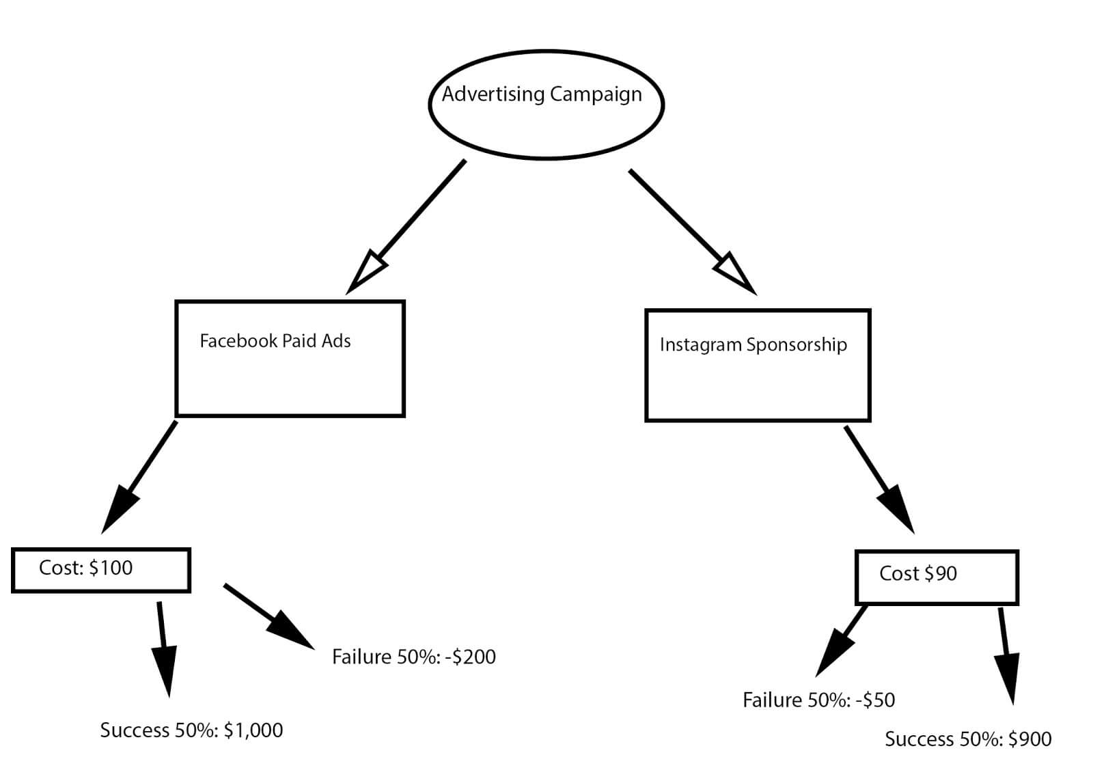
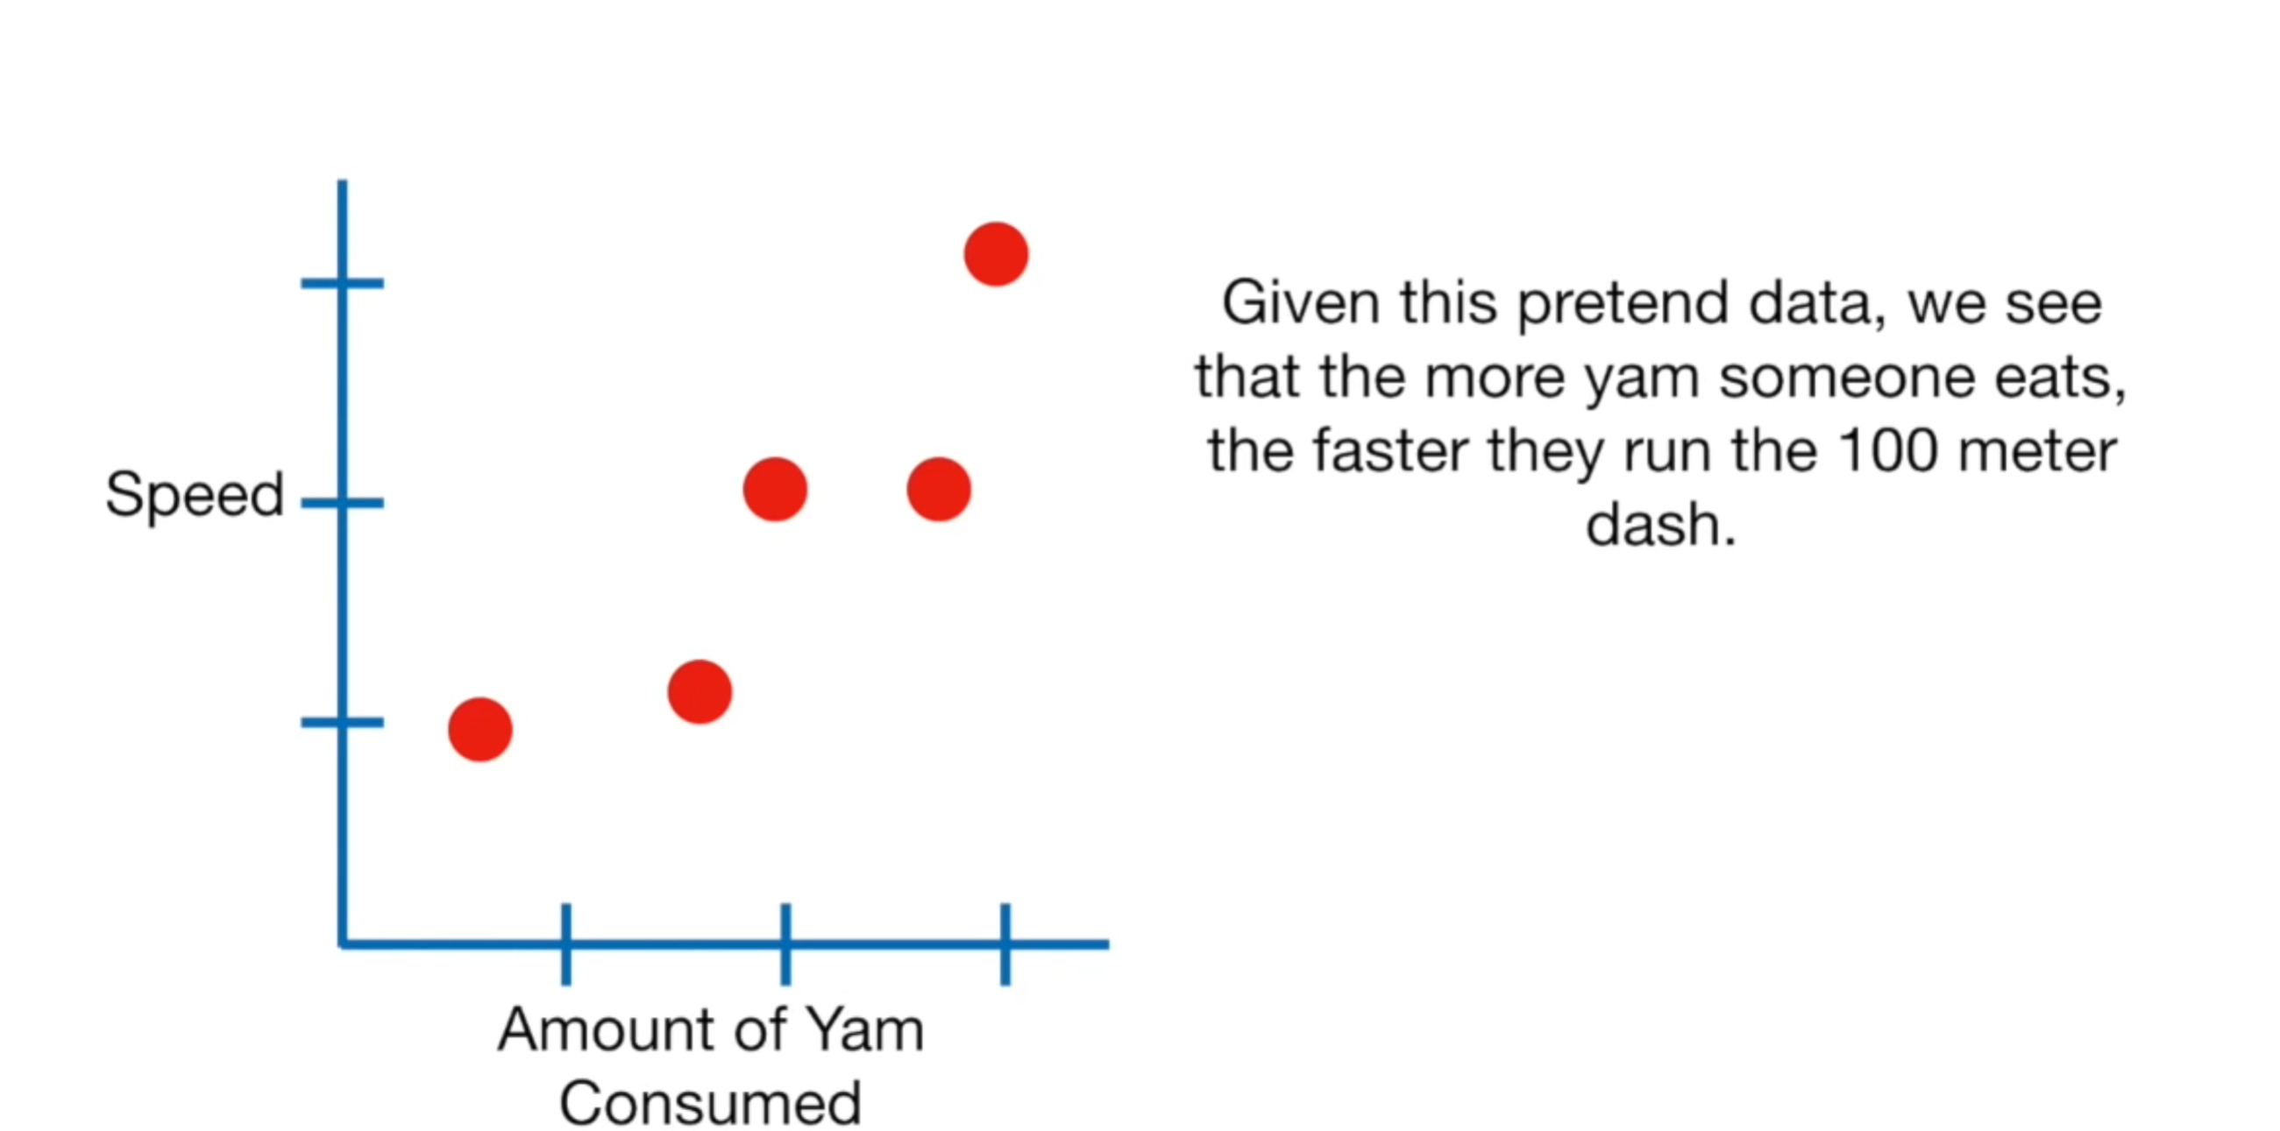
Machine learning has two primary objectives: prediction and classification.
Let's take a look at a few examples:

Slide 4
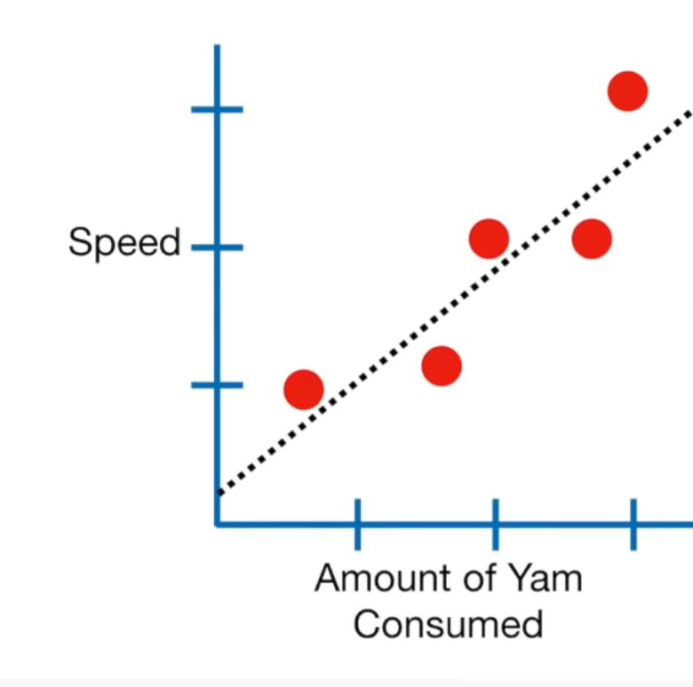
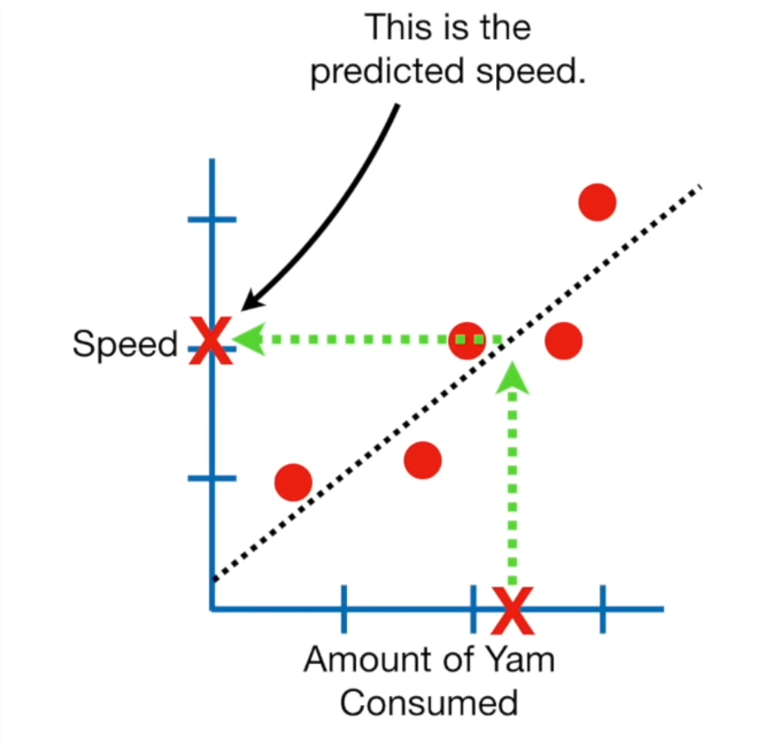
Machine Learning
We can draw a trendline to represent the trend (left image), and this line can be used for prediction (right image)
draw a trendline
This leads to the speed of prediction
When there is such a level of consumption

Slide 5

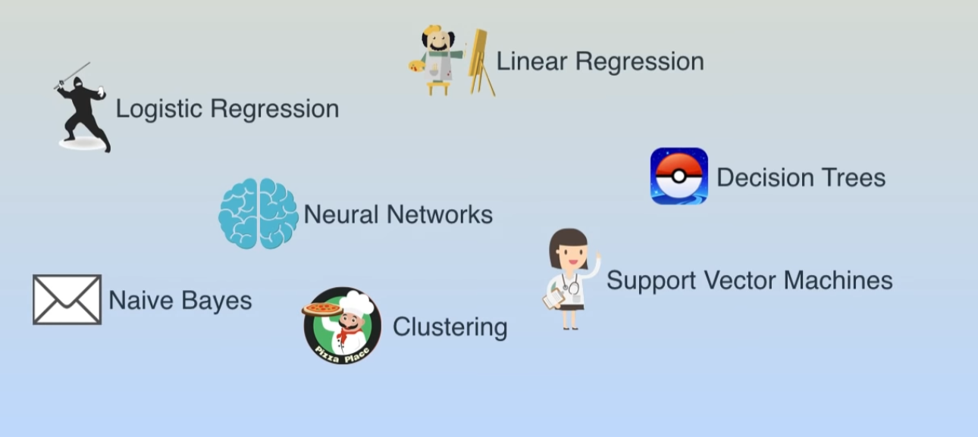
Some machine learning algorithms

Slide 6
Linear Regression

Slide 7
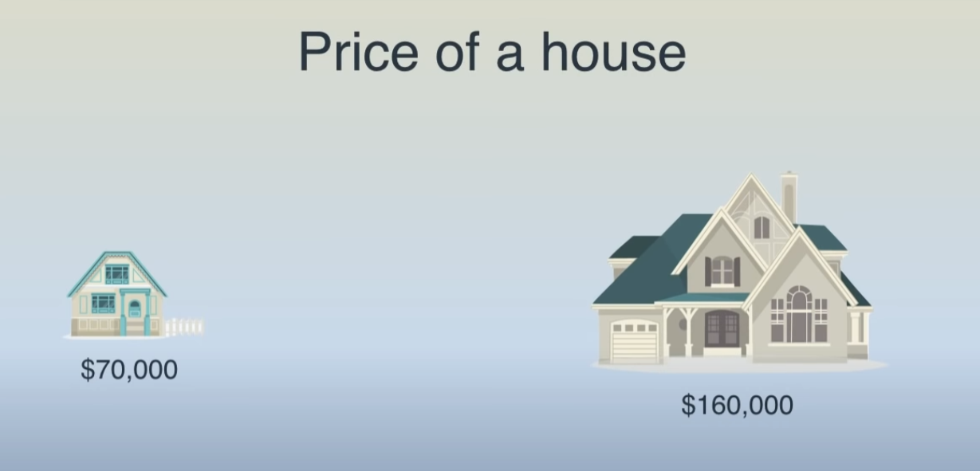
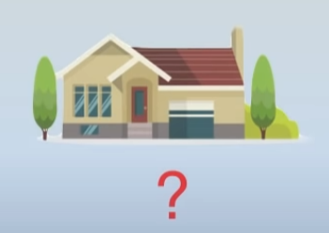
Linear Regression

Slide 8
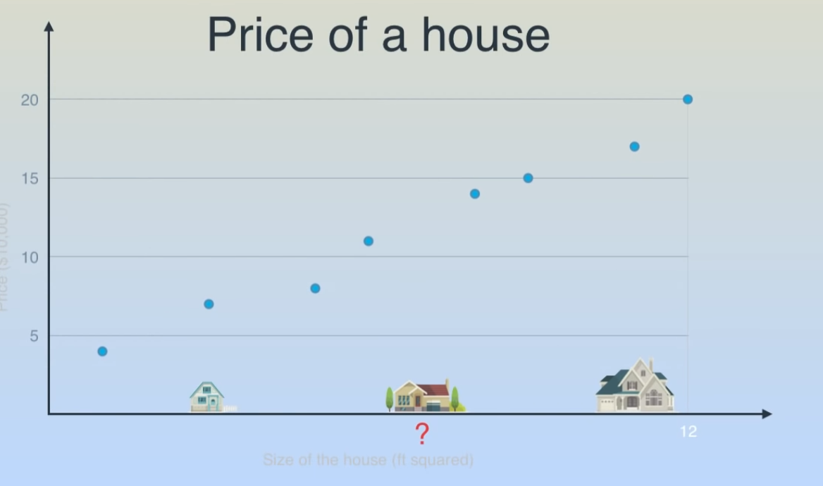
Linear Regression
First, collect some data on house prices
Find this line
$160,000
？？？
$70,000
？？？

Slide 9
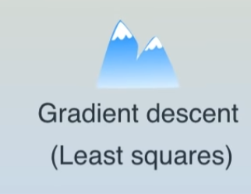
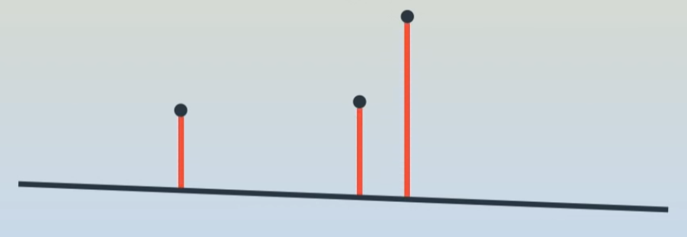
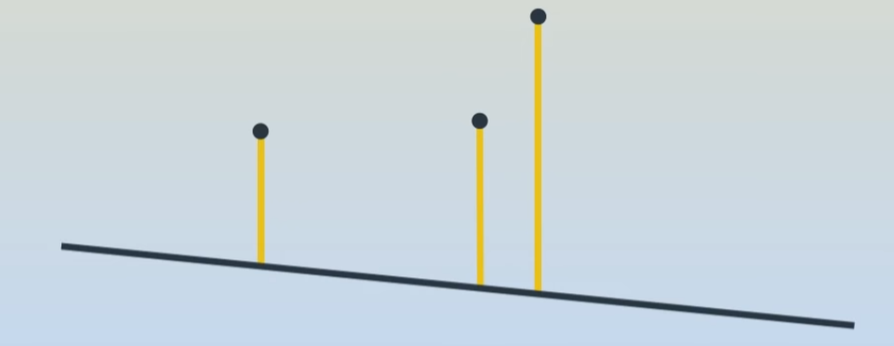
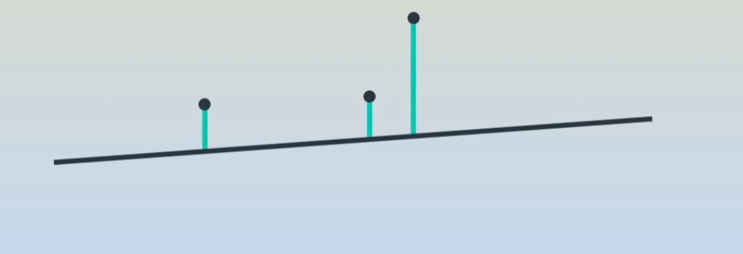
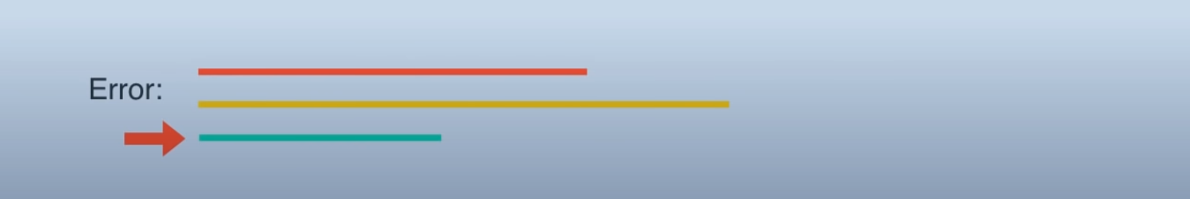
Linear Regression
How to find this line?

Slide 10
Naïve Bayes Algorithm

Slide 11
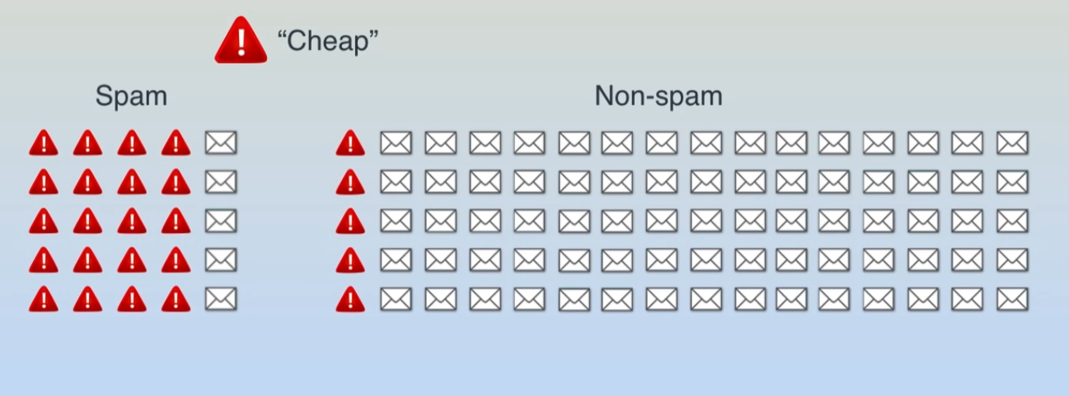
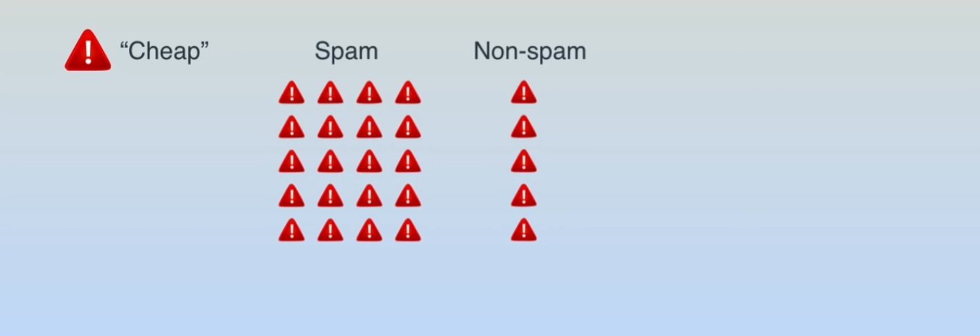
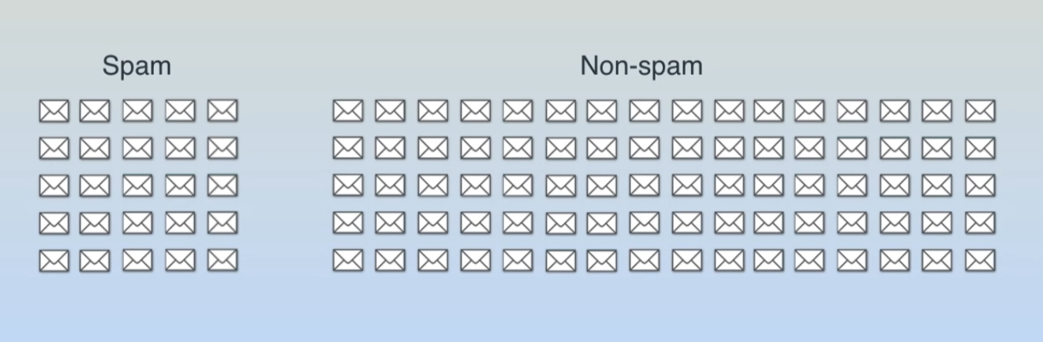
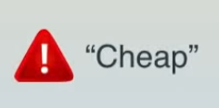
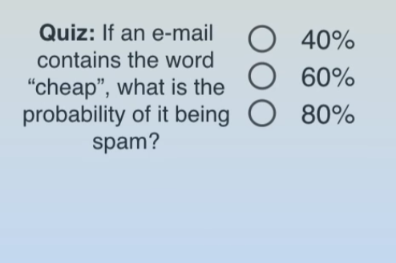
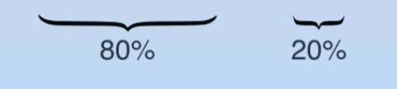
Naïve Bayes Algorithm
Detecting Spam e-mails
Conclusion: If an email contains the word 'cheap,' there is an 80% chance that the email is spam.

Slide 12
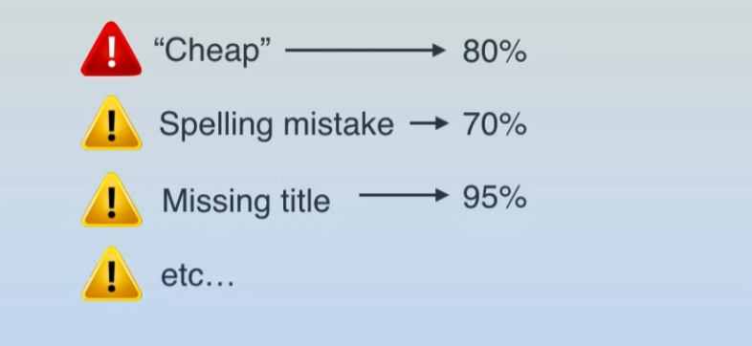
Naïve Bayes Algorithm
By adding other conditions, you can predict the probability of an email

Slide 13
Decision Tree

Slide 14
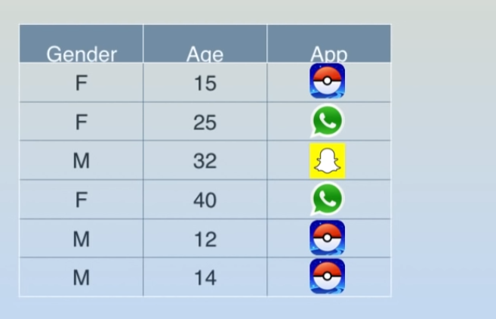
Decision Tree
Recommendations for using apps
Assuming the collected data is as follows:
Between gender and age, which one is more predictive of the types of apps users download?

Slide 15
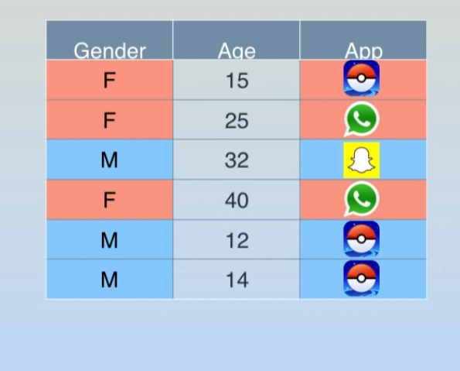
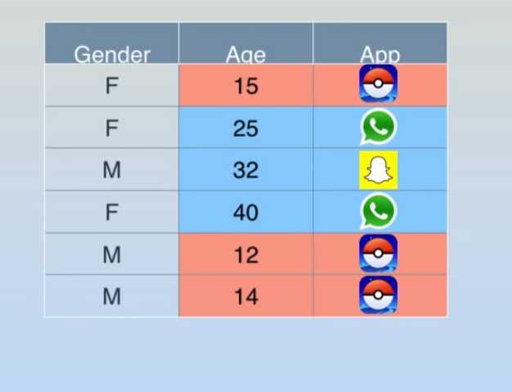
Decision Tree
Recommending Apps
gender
age
It appears that age can be used for initial differentiation

Slide 16
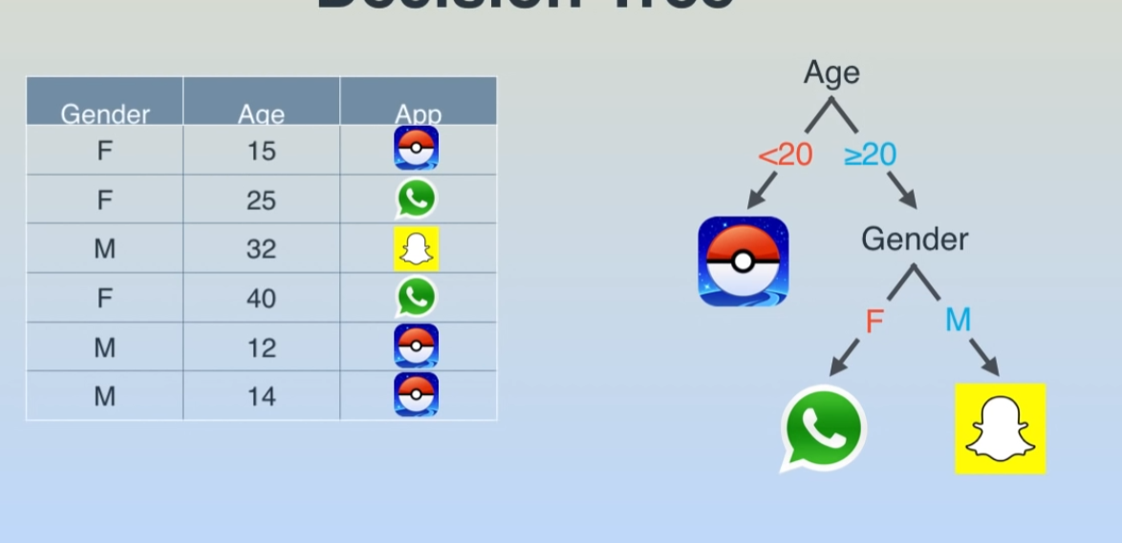
Decision Tree
Recommending Apps

Slide 17
Logistic Regression

Slide 18

Logistic Regression
University's Assessment of Applicants:
Assuming there are two factors to consider:
exam scores and in-school Grades:

Slide 19
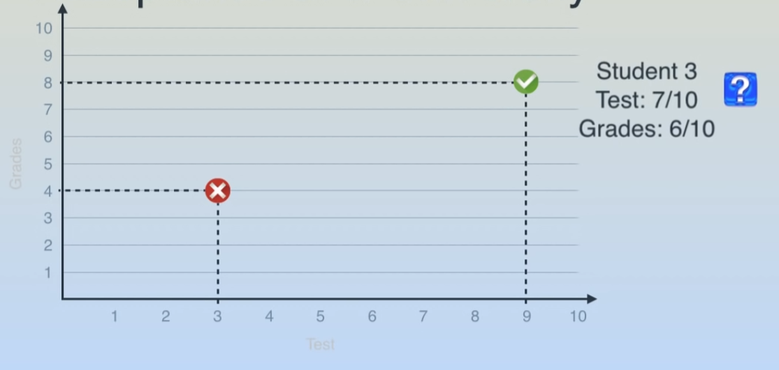
Logistic Regression
University's Assessment of Applicants:

Slide 20
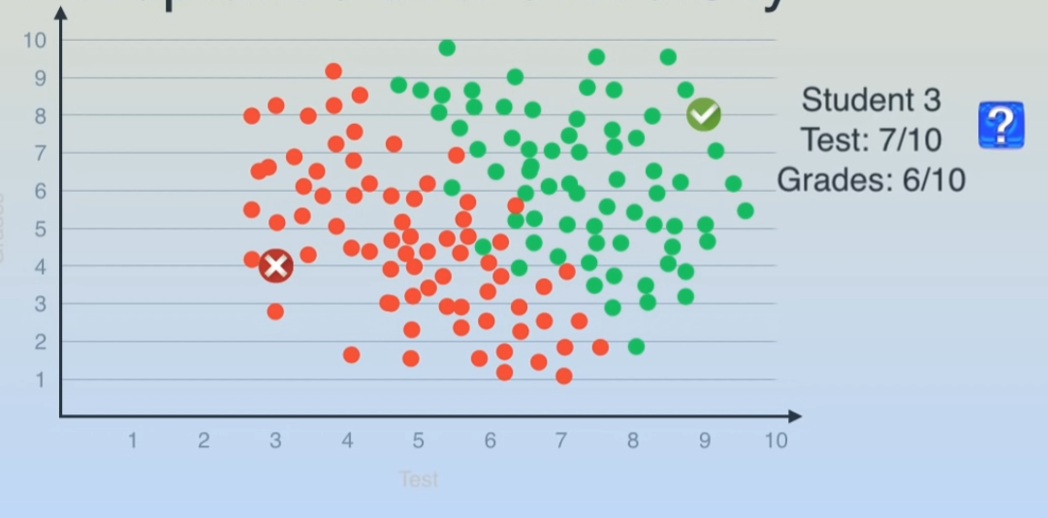
Logistic Regression
Collecting past data:
Identify a dividing line

Slide 21
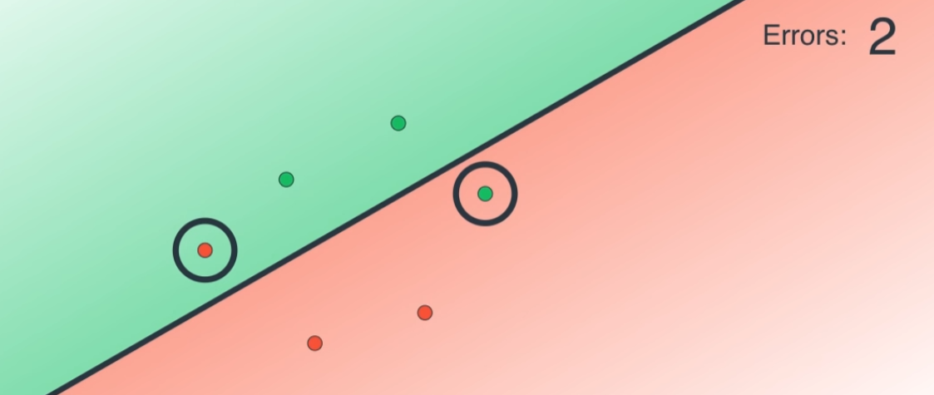
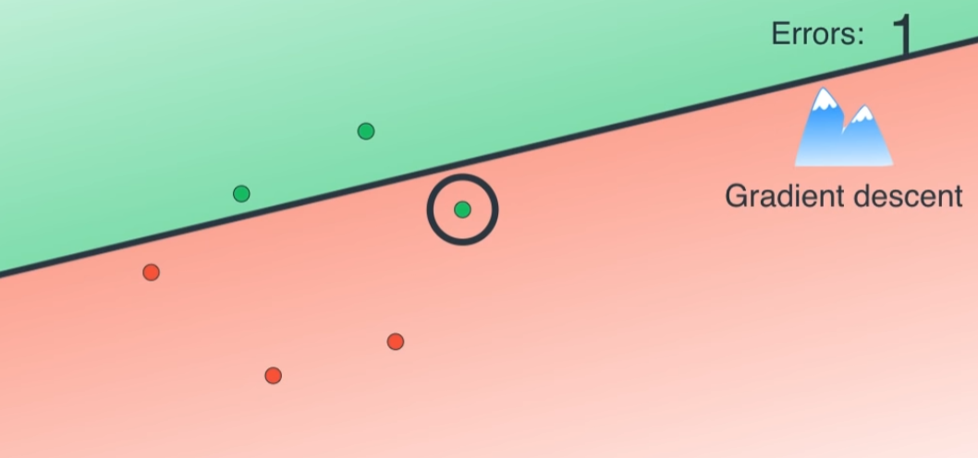
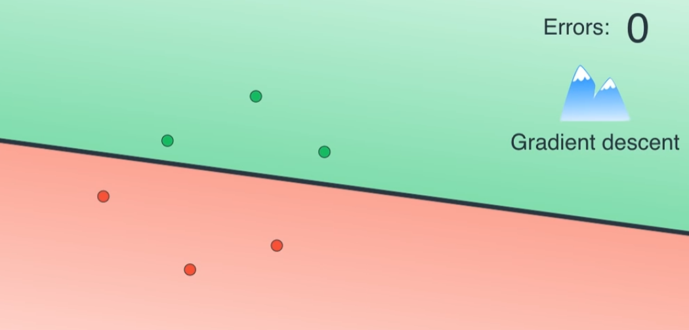
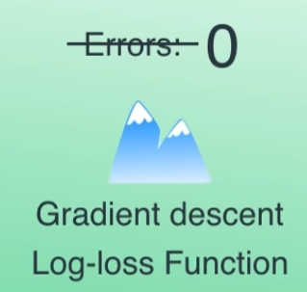
Logistic Regression
How to find the best possible line?

Slide 22
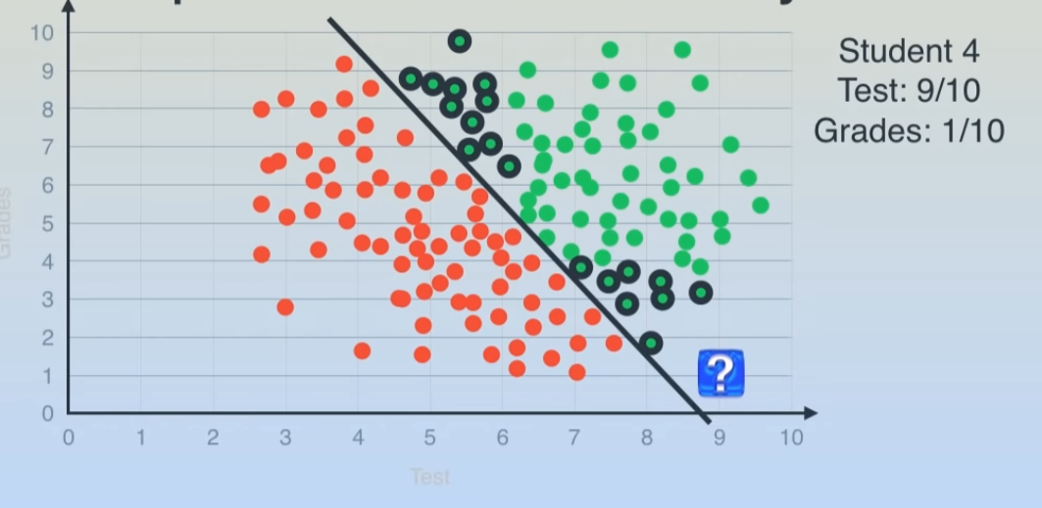
Logistic Regression
These are the same as well
The grades are too low;
they should not pass

Slide 23
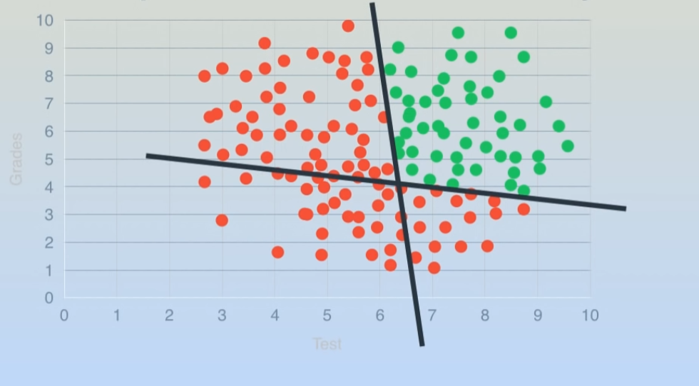
Logistic Regression
a single line is not sufficient
Two cutting lines seem more appropriate for comparison

Slide 24
Neural Network

Slide 25
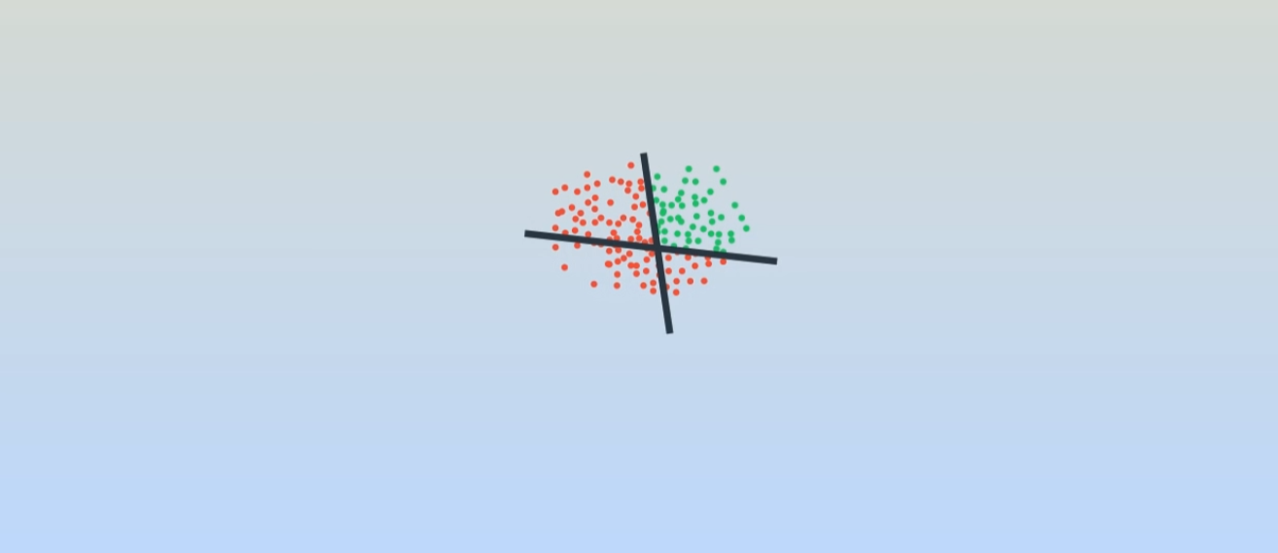
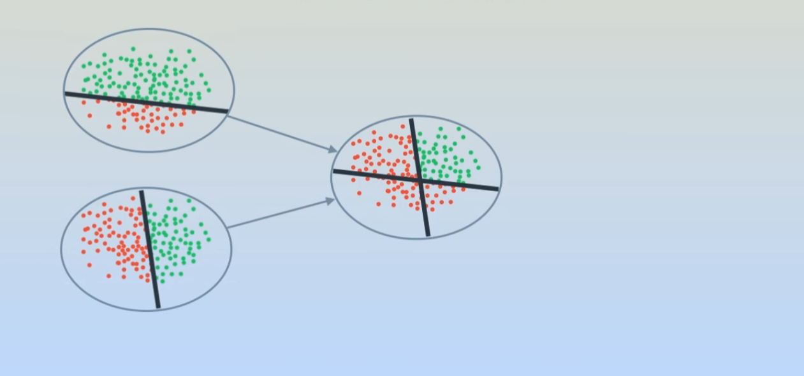
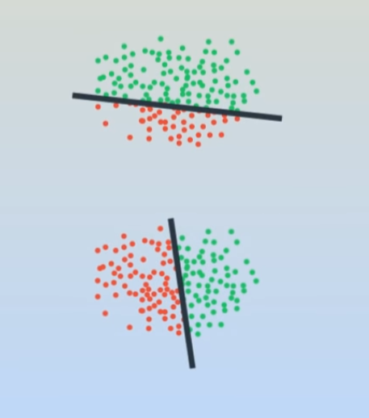
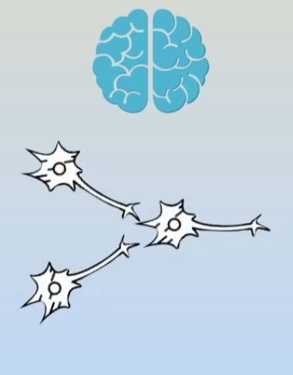
Neural Network

Slide 26
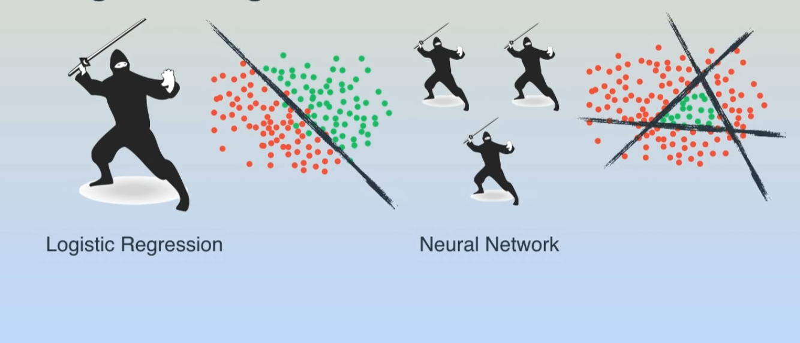
Neural Network
Logistic Regression Neural Network

Slide 27
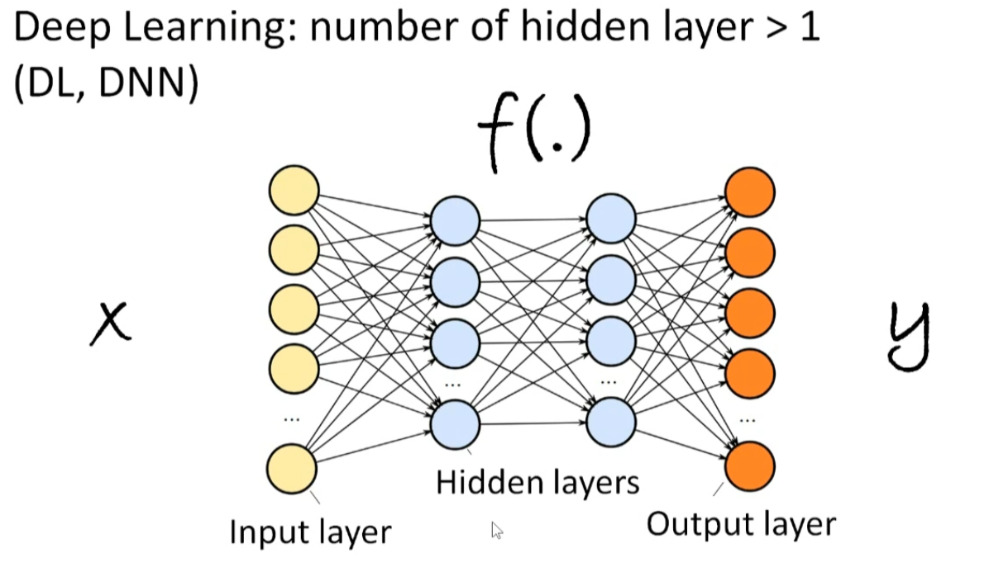
Deep Learning
The Input Layer receives signals from neurons, the Hidden Layer is the intermediate layer, and the Output Layer produces the response. The strength of the signal transmitted by each neuron is represented as a weight (W), which is the parameter the model needs to solve. Once calculated, we have a formula. With input signals passed through layer by layer, we can deduce the result.
If there are more than 2 Hidden Layers, it is referred to as 'Deep Learning'
W_{i, j}
W_{k, l}
W_{j, k}

Slide 28

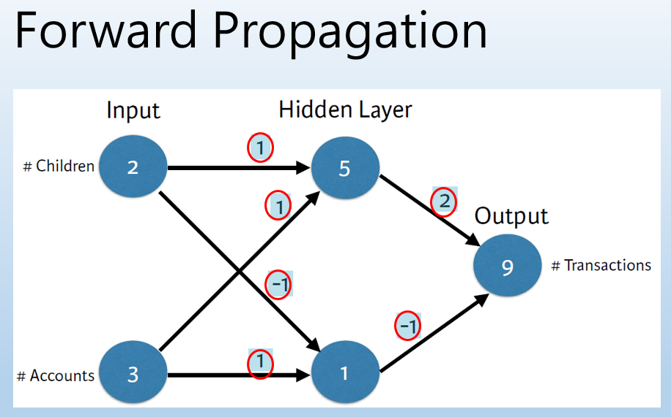
Neural Network
Let's consider an example:
Let's start by arbitrarily assuming a set of weights (W), as indicated by the numbers inside the red circles in the diagram.
In each layer, the output is equal to the input from the previous layer multiplied by the weights (W), expressed as y = sum(w * x).
This process is called Forward Propagation.
For example, consider the first node in the hidden layer, which is equal to 2 * 1 + 3 * 1 = 5.
The second node in the hidden layer is equal to 2 * -1 + 3 * 1 = 1.
The output layer is then equal to 5 * 2 + 1 * -1 = 9.
Source：DataCamp Deep Learning in Python

Slide 29
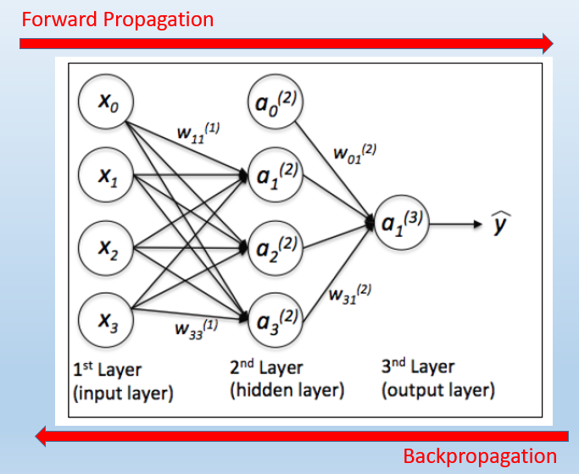
Neural Network
First, construct the model by determining the number of hidden layers. Then, use Forward Propagation and Backpropagation to calculate the most important parameter in the model, which is the 'weight.’
This process is referred to as 'optimization,' and the most commonly used technique is 'Gradient Descent
Source:
https://ithelp.ithome.com.tw/articles/10191528

Slide 30
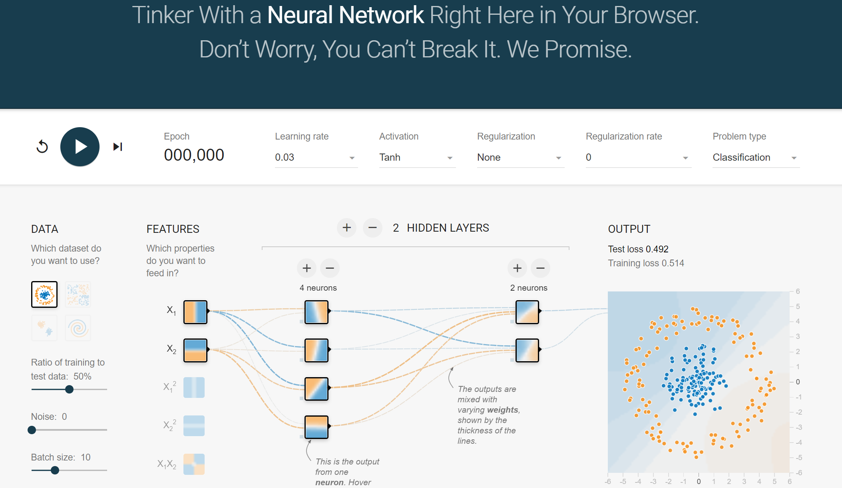
https://playground.tensorflow.org/

Slide 31
Gradient Descent

Slide 32
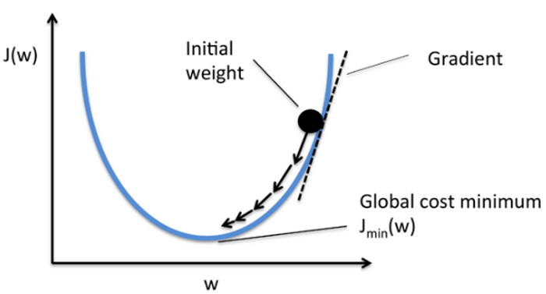
Gradient Descent
We use the 'Gradient Descent' method to approximate the weights (W), which is the process of optimization.
Gradient Descent is similar to 'being at the top of a mountain but not knowing the way down, so we follow the paths that go downhill the most until we reach flat ground.’
To find the steepest downhill path, mathematical concepts like 'partial derivatives' are often used to calculate the slope, allowing us to approach step by step. The process is as follows

Slide 33
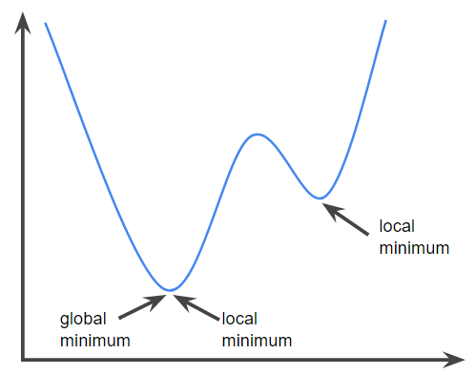
But if the loss function is like this, it's not easy to find the best solution.

Slide 34
Gradient Descent
Let's use a visual representation to explain the difference in learning rates:
Learning rate = 0.01
Learning rate = 0.1
Learning rate = 0.9

Slide 35
Gradient Descent
The difference in learning rates for functions with local minima and global minima
Learning rate = 0.00001
The learning rate is too small, and the initial value is not ideal
Learning rate = 0.0004
The learning rate is large enough to escape local minima, but the steps are too big to reach the best value.
Learning rate = 0.0003
It can reach the global minimum

Slide 36
K-Means Clustering

Slide 37
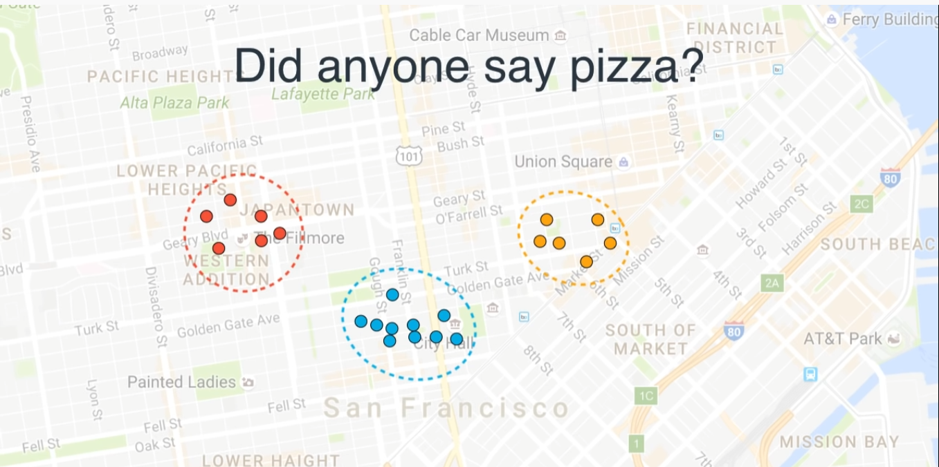
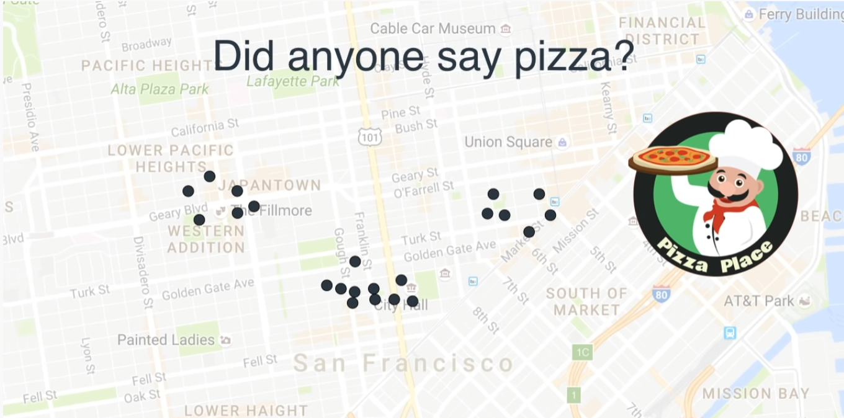
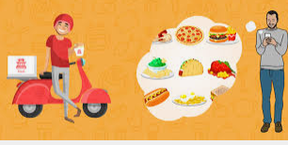
K-Means Clustering
We have collected the distribution of people ordering pizza delivery as follows. How do we choose the location for a restaurant?
常叫外送餐飲的人分布
人眼分群很容易，
要如何教電腦來分群？

Slide 38
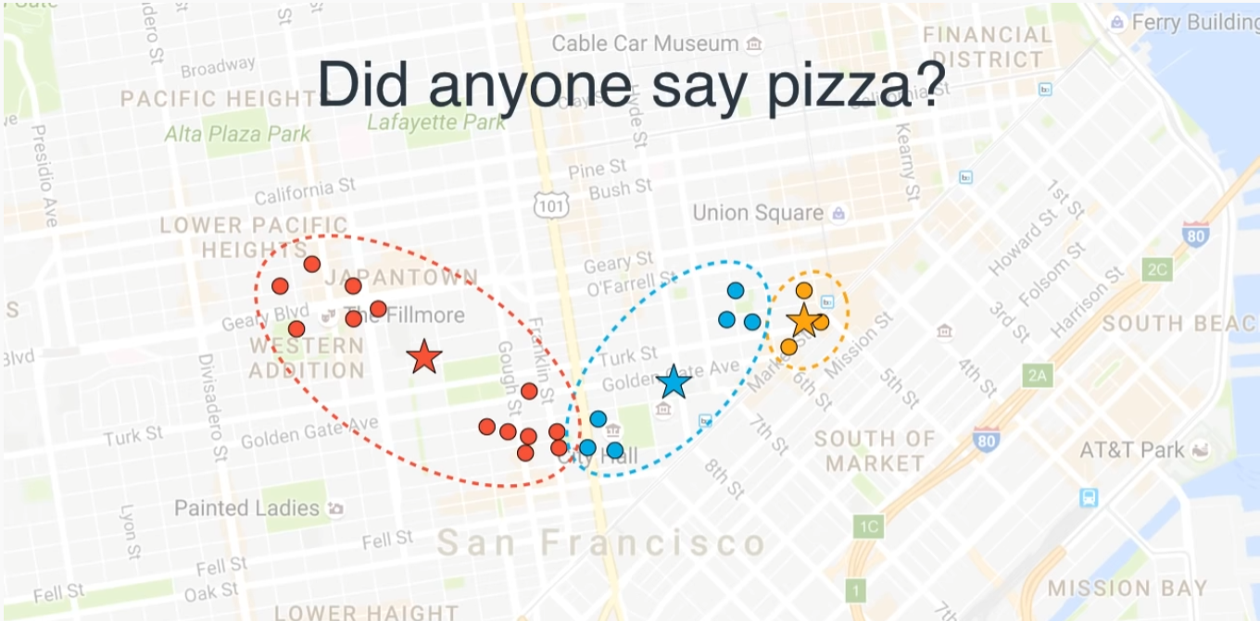
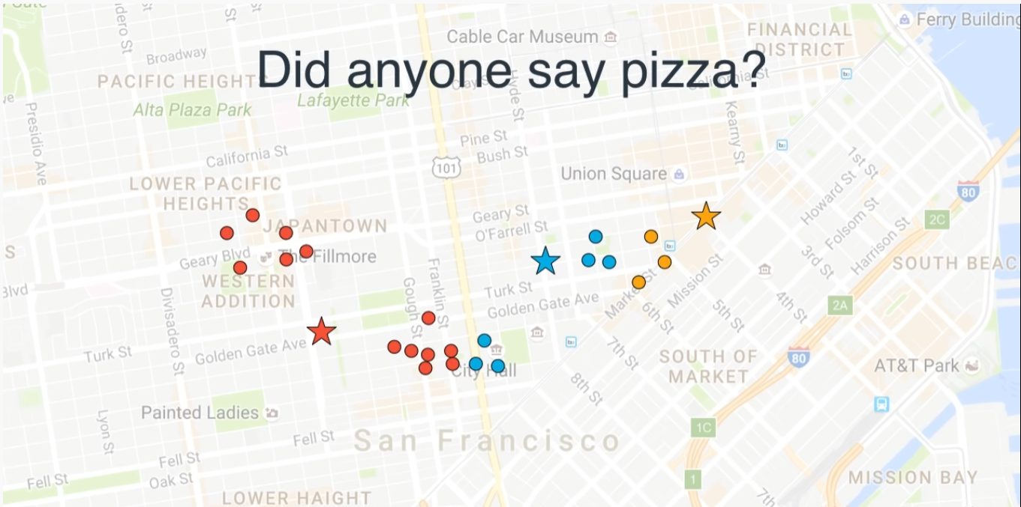
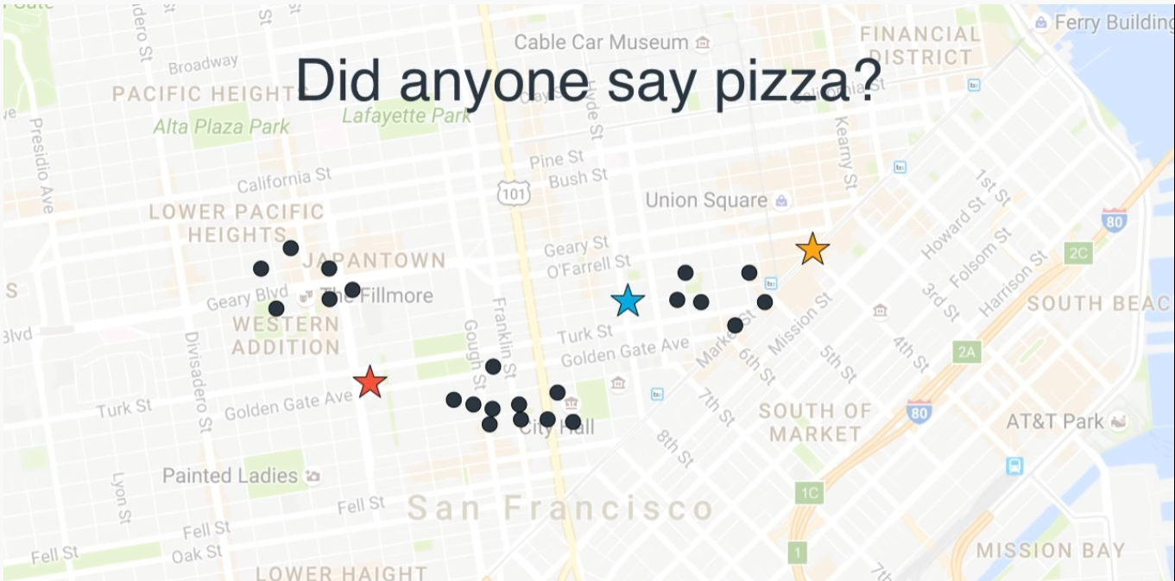
K-Means Clustering
Start by randomly selecting three points, assuming that each person wants to go to the nearest restaurant.
Next, move the restaurant locations to the center of each group.

Slide 39
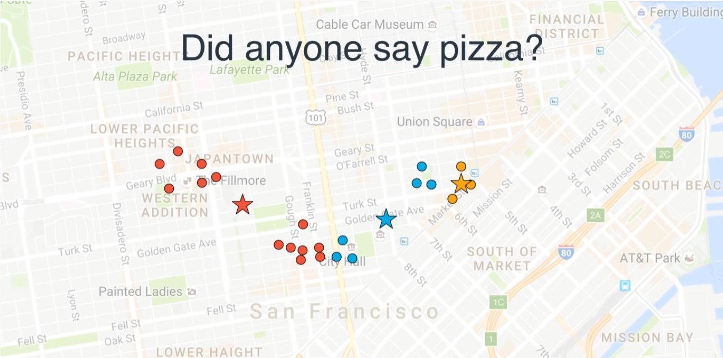



K-Means Clustering
That way, you can obtain the clustering result!
Repeat the process of moving the restaurant locations to the center.
At this point, you may need to adjust the colors again
At this stage, the distances have changed, so you may need to adjust the colors again.
Then move the restaurant locations to the center.

Slide 40
Support Vector Machine ( SVM)

Slide 41



Support Vector Machine
Assuming we are observing a group of students, here is some data about the weight of some of these students:

Slide 42



Support Vector Machine

Slide 43


Support Vector Machine
So, we can say that the threshold value was not set correctly!
Is there a good method for determining the threshold value?

Slide 44



Support Vector Machine

Slide 45



Support Vector Machine

Slide 46

Support Vector Machine

Slide 47

Support Vector Machine
If we allow for some margin of error in the judgment, it can actually work better.

Slide 48


Support Vector Machine

Slide 49

Support Vector Machine

Slide 50

Support Vector Machine

Slide 51

Support Vector Machine

Slide 52

Support Vector Machine

Slide 53

Support Vector Machine
When our data includes both weight and height values, it becomes two-dimensional data.

Slide 54

Support Vector Machine

Slide 55

Support Vector Machine

Slide 56


Support Vector Machine
Another way to put it: SVM finds the best classification method, which means the widest street.
00
00

Slide 57

Support Vector Machine

Slide 58
Why 3D？

Slide 59

Support Vector Machine
If our data looks like this, with the horizontal axis representing the amount of medication dosage used:

Slide 60

Support Vector Machine
We try to add a Y-axis, for example: y = x^2.

Slide 61


Support Vector Machine

Slide 62

Support Vector Machin
SVM uses kernel functions to systematically search for high-dimensional support vector classifiers (SVC)

Slide 63

Support Vector Machine

Slide 64

Support Vector Machine
Z
xy = 2
xy = 1
xy = 0

Slide 65

Support Vector Machine

Slide 66
Convolutional Neural Network - CNN

Slide 67

Convolutional Neural Network
The concept diagram of CNN is as follows:
Images go through two rounds of Convolution, Pooling, and Fully Connected layers to form the structure of a CNN.

Slide 68

Convolutional Neural Network

Slide 69

Convolutional Neural Network
Convolution operation involves performing a convolution (symbol ⊗) between the original image and a specific Feature Detector (filter)
The convolution operation is essentially multiplying two 3x3 matrices element-wise and then summing the results, as shown in the following image. 0*0 + 0*0 + 0*1+ 0*1 + 1 *0 + 0*0 + 0*0 + 0*1 + 0*1 =0

Slide 70

Continuing the process for the entire table:

Slide 71

In the middle, multiple Feature Detectors (Filters) will be randomly generated (e.g., 16 filters). The purpose of Feature Detectors is to help extract some features from the image (e.g., shapes). It's like the human brain trying to figure out what an image represents based on its shapes.

Slide 72


In the Pooling Layer, Max Pooling is mainly used, which is a simple concept of selecting only the maximum value in a matrix.
The primary advantage of Max Pooling is that shifting the entire image by a few pixels won't affect the judgment at all. It also has excellent noise resistance.

Slide 73


The Fully Connected Layer is essentially where the results from previous layers are flattened and connected to the most basic neural network.

Slide 74
????????

Slide 75


The principle of intermediate feature maps:
Suppose today we want to recognize X
X can be written in various ways:
First, let's try to identify the features of X:

Slide 76




We extract the features using mathematical methods.
We set white as 1 and black as 0
First, let's consider a 3x3 Feature Detector that detects a diagonal pattern from the top left to the bottom right
Applying it to the original image, multiplying, and summing, we obtain a Feature Map.

Slide 78

Next, the second cell:

Slide 79
The meaning represented by the feature map.
Feature Detector is a 3x3 diagonal from top left to bottom right
In the resulting feature map, the middle three cells have the maximum value of 3
Which means that these three cells represent the presence of this diagonal feature in the image.
We use this to detect diagonals from top right to bottom left
By using different Feature Detectors, you can identify where a particular feature appears in the image.
Next, let's look at pooling.
2 | 0 | 1 | 0 | 1
0 | 3 | 0 | 1 | 0
1 | 0 | 3 | 0 | 1
0 | 1 | 0 | 3 | 0
1 | 0 | 1 | 0 | 2

Slide 80

pooling
Pooling is the process of simplifying the feature map, typically using the method of Max Pooling.
This smaller feature map still retains the original features.
2 | 0 | 1 | 0 | 1
0 | 3 | 0 | 1 | 0
1 | 0 | 3 | 0 | 1
0 | 1 | 0 | 3 | 0
1 | 0 | 1 | 0 | 2
3
1
1

Slide 81

How are Feature Detectors determined?
During the process of machine learning, Feature Detectors are adjusted in a reverse manner to find the most suitable ones

Slide 82
Images go through two rounds of Convolution, Pooling, and Fully Connected layers.

Slide 83


Slide 85
Why GPU?
Although it involves simple multiplication and addition, for an 800x600 RGB color image:
800x600x3 = 1,440,000 pixels
Performing convolution with a 3x3x3 Feature Detector requires 13 million multiplications and 12 million additions. This is just for processing one 800x600 image using one Feature Detector.
During the learning process, if there are thousands of images to process thousands of times, it can be computationally intensive."

Slide 86

https://www.youtube.com/watch?v=-P28LKWTzrI

Slide 87


Slide 88
Detection Model

Slide 89

Detection Model
In deep learning, frameworks are created to facilitate the expression of the structure, training, and inference processes of models (Net/Model).
Many academic institutions, open-source communities, and even well-known companies have introduced their own frameworks, including TensorFlow, Caffe, Keras, CNTK, Torch7, MXNet, Leaf, Theano, DeepLearning4, Lasagne, Neon, and more, as shown in the following diagram:

Slide 90
DetectionModel
Commonly used network model structures include supervised models like Convolutional Neural Networks (CNN), sequential models like Recurrent Neural Networks (RNN), reinforcement learning (e.g., Q-Learning), transfer learning, and Generative Adversarial Networks (GAN).
In Python, you can load pre-trained models trained with these frameworks using OpenCV, which allows you to perform recognition tasks.
Common frameworks include TensorFlow, Caffe, Darknet, and more.

